Slide 1


Data analysis and modeling on National Pollutant Release Agency
Presentated by Akash, vanshnoor

Slide 2
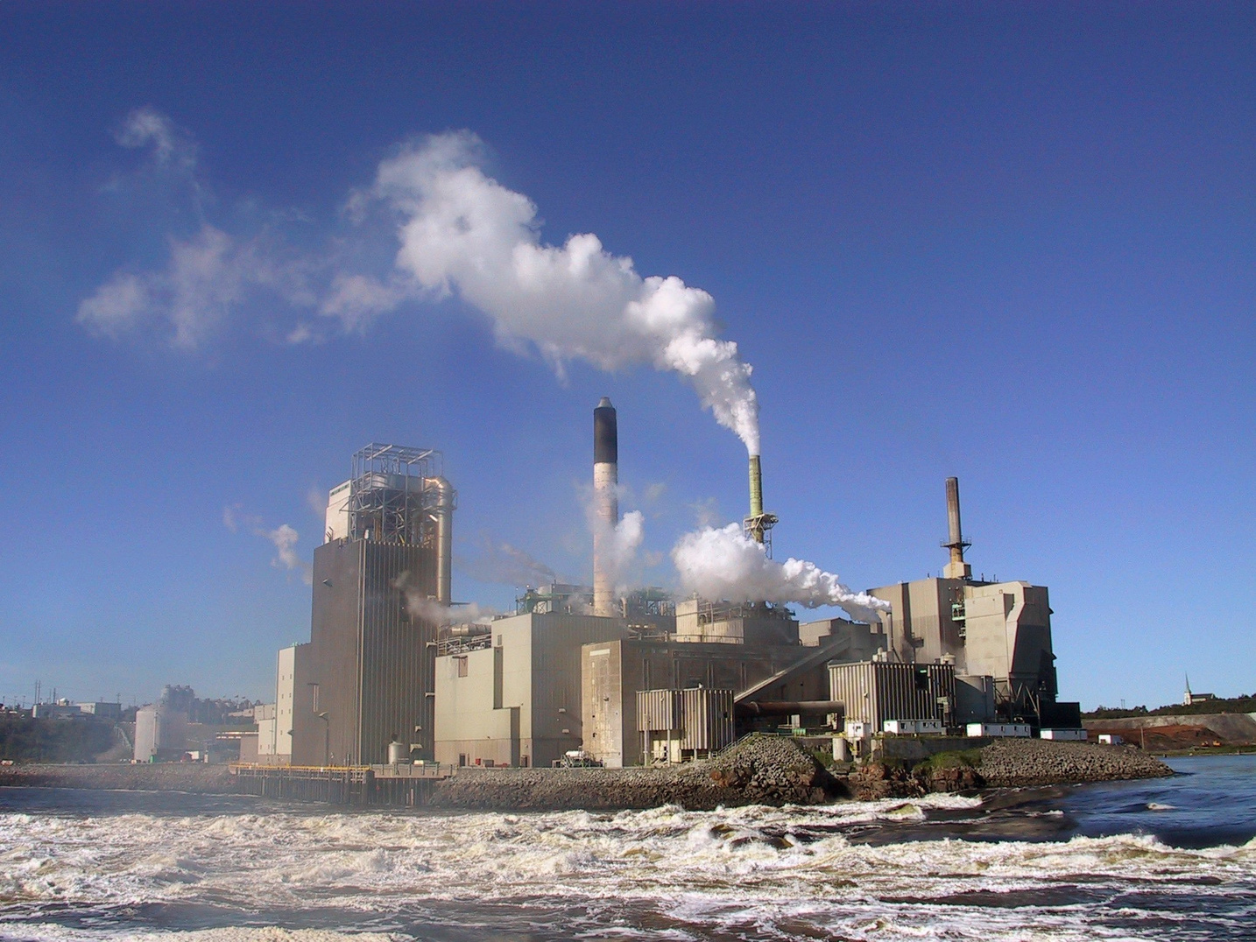
Problem statement
Which Industry is Predicted to have highest and lowest realizes in the year 2022 ?.

Slide 3
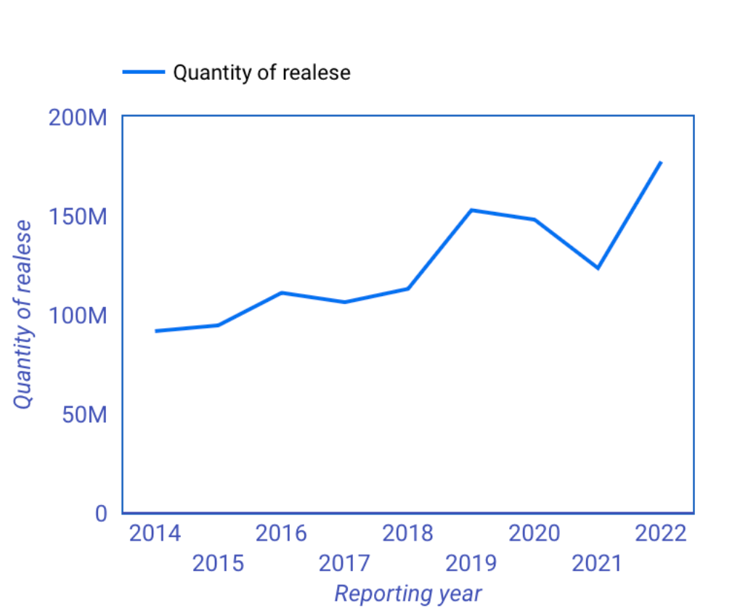
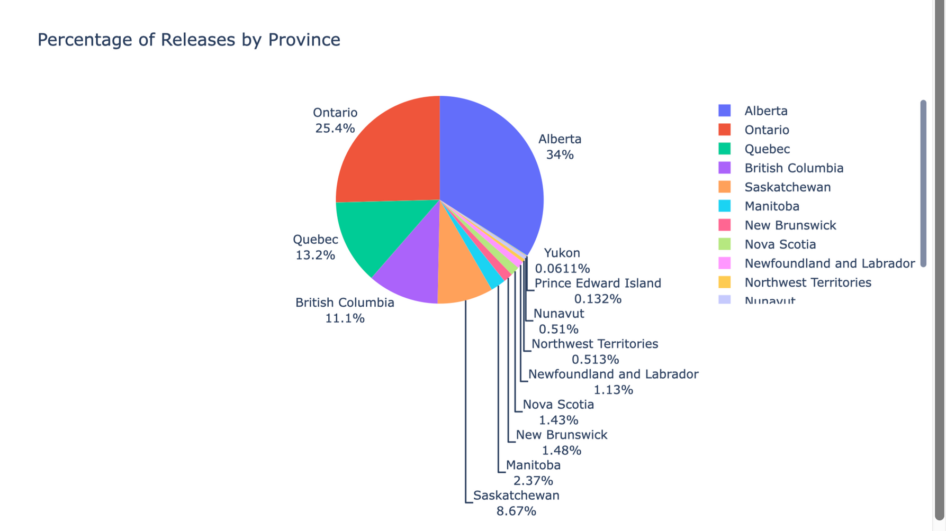
Data Visualization
Percentage of Realeses by Provinces

Slide 4
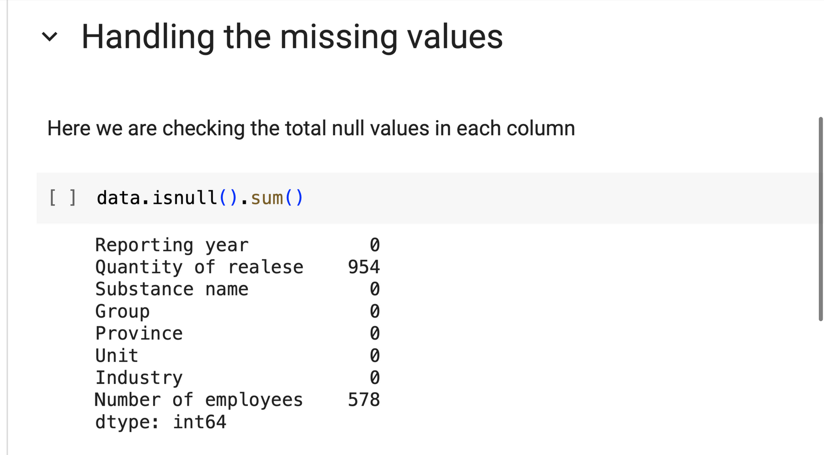
Finding and handling missing values
Columns with missing values
Quantity of realese
Number of employees
Option 1: Fill Missing values with Mean Value Filling NaNs with the mean value is also not sufficient and naive, and doesn't seems to be a good option.
Option 2: Fill NaN with Last Value with .ffill() Filling NaNs with the last value could be bit better.
Option 3: Fill NaN with Linearly Interpolated Value with .interpolate() Filling NaNs with the interpolated values is the best option in this case.

Slide 5
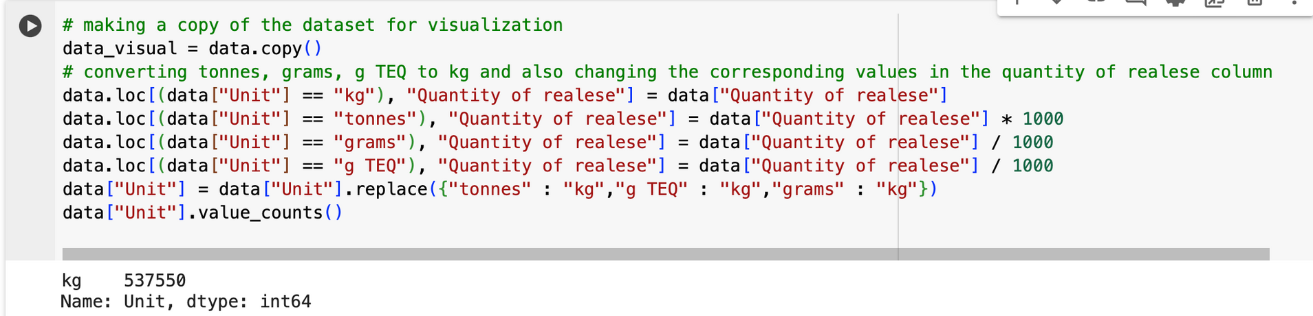
Handling Unit column
Converting each unit to kg with its corresponding value in the quantity column

Slide 6

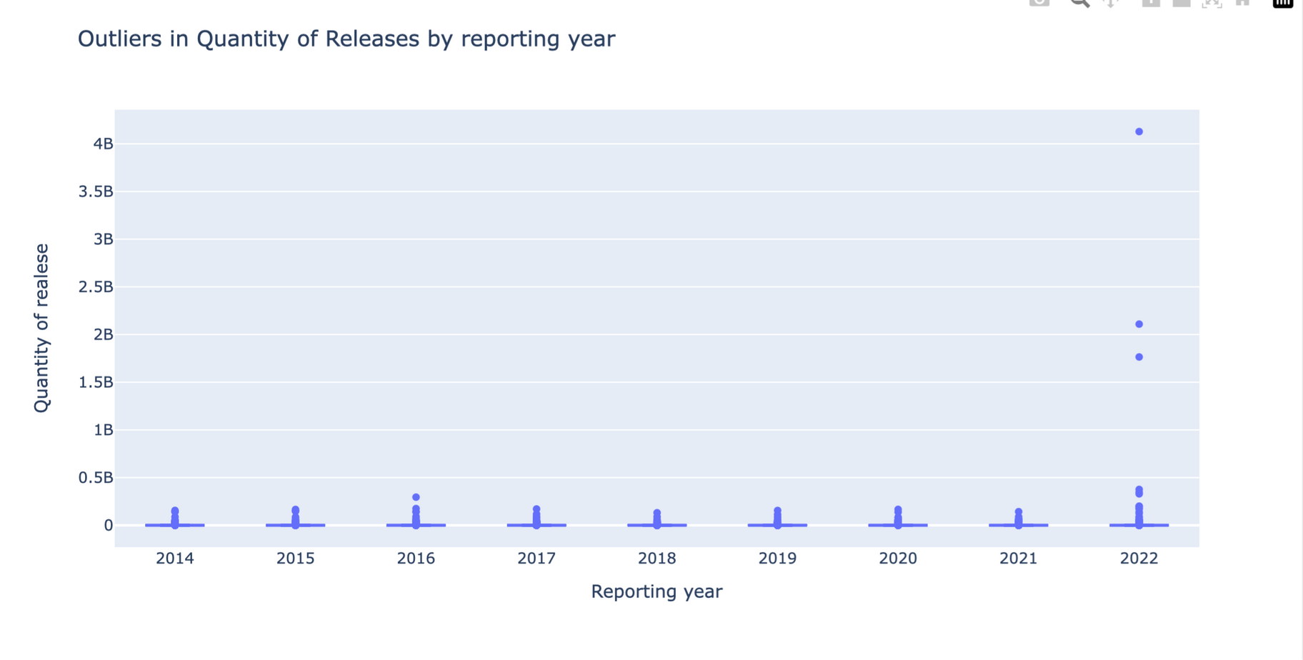
Outlier Detection

Slide 7
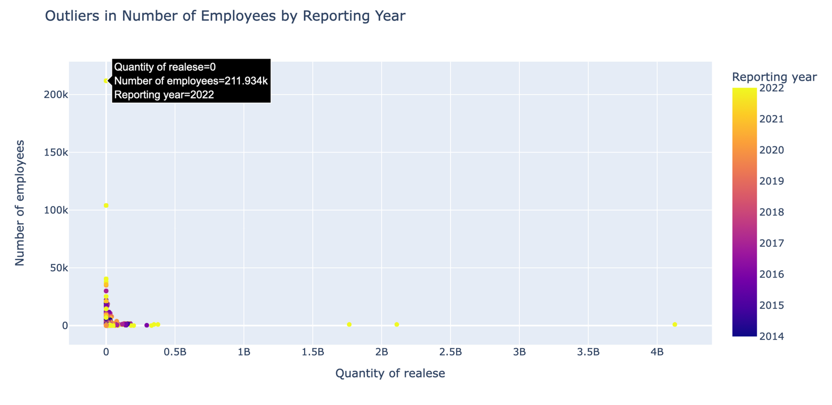
Scatter plot showing outliers in number of employees column

Slide 8


Model Description
We are using K nearest neigbour
k
imple Implementation: Implementing KNN is straightforward and requires minimal parameter tuning
It can be applied to both classification and regression problem. In classification, it assigns the majority class among knn neighbours while in regression it assigns the average
Implementing KNN is straightforward and requires minimal parameter tuning. The main hyperparameter to specify is the value of nearest neighbours
Knn can perform well in the presence of noisy or irrelevent features

Slide 9

Seprating the data by year.
From 2014 to 2021 year is extracted by seprating the year 2022 data from the whole dataset.
01
Model is trained on data from 2014 to 2021 year.
Overview of Training and Test data
02
For Predicting the industry with low releases, we passed data of 2022 year through the model becauses model have trained on past years data. So, now it can predict for 2022 year.
03

Slide 10
Results
Low
PETROLEUM REFINERIES
low
Medium
OIL AND GAS EXTRACTION
low
low
High
REMEDIATION SERVICES
Very High

Slide 11
Thank you

